Slide 1
Files

Slide 2
Agenda
File concept
File pointer
File handling operations (open, close, read, write etc) on sequential and random access files.
Programs on file manipulations using fgetc(), fgets(),fseek()

Slide 3
File concept Why do we need File Handling in C?
The output of a C program is generally deleted when the program is closed. Sometimes, we need to store that output for different purposes.
Some uses of file handling
Reusability: The file-handling process keeps track of the information created after the program has been run.
Portability: Without losing any data files can be transferred to another in the computer system. The risk of flawed coding is minimized with this feature.
Efficient: A large amount of input may be required for some programs. File handling allows you to easily access a part of a code using individual commands which saves a lot of time and reduces the chance of errors.
Storage Capacity: Files allow you to store data without having to worry about storing everything simultaneously in a program.

Slide 4
Types of Files
There are two types of files
Text files
Binary files

Slide 5
1. Text files
Text files are the normal .txt files.
You can easily create text files using any simple text editors such as Notepad.
All the contents within the file are plain text.
2. Binary files
Binary files are mostly the .bin files in your computer.
Instead of storing data in plain text, they store it in the binary form (0's and 1's).
They can hold a higher amount of data, are not readable easily, and provides better security than text files.

Slide 6
The following operations can be performed on a file.
Creation of a new file (fopen())
Opening an existing file (fopen())
Reading from file (fscanf() or fgets())
Writing to a file (fprintf() or fputs())
Moving to a specific location in a file (fseek(), rewind())
Closing a file (fclose())

Slide 7
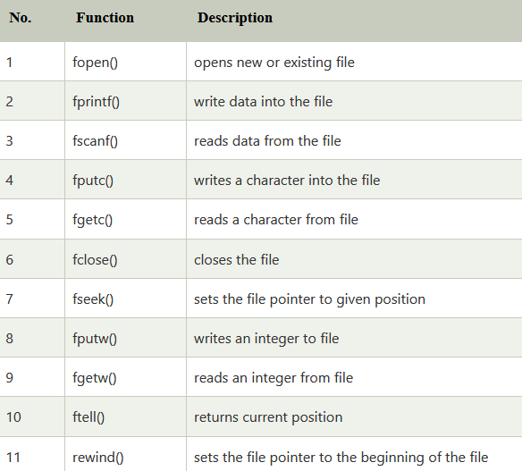
Functions for file handling

Slide 8
Working with files
you need to declare a pointer of type file.
This declaration is needed for communication between the file and the program.
FILE *fptr;

Slide 9
Opening a file - for creation and edit
The syntax for opening a file in standard I/O is:
ptr = fopen("fileopen","mode");
Eg:
fopen("E:\\cprogram\\newprogram.txt","w"); fopen("E:\\cprogram\\oldprogram.bin","rb");

Slide 10
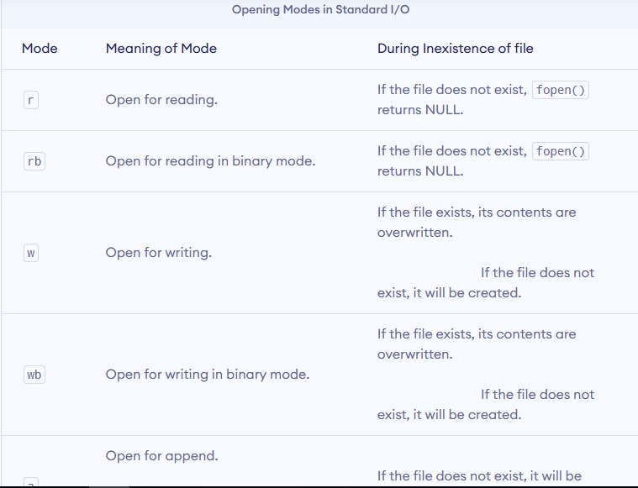

Slide 11
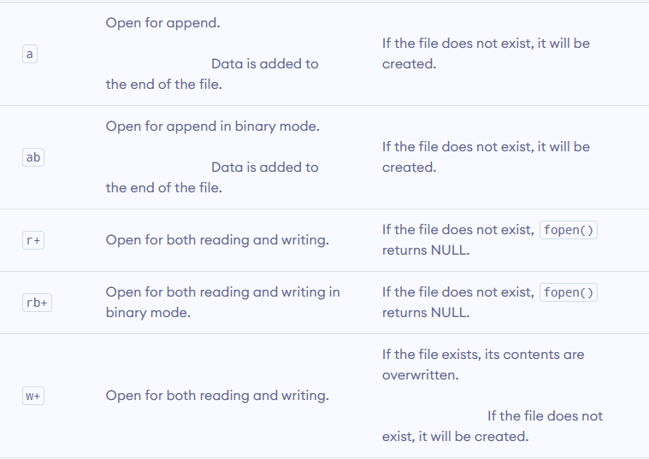

Slide 12
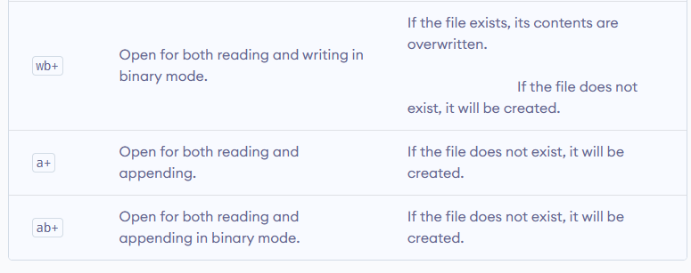

Slide 13
Closing a File
The file (both text and binary) should be closed after reading/writing.
Closing a file is performed using the fclose() function.
fclose(fptr);

Slide 14
Reading and writing to a text file
For reading and writing to a text file, we use the functions fprintf() and fscanf().

Slide 15
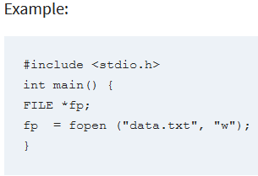
In the given syntax, the filename and the mode are specified as strings hence they must always be enclosed within double quotes.

Slide 16
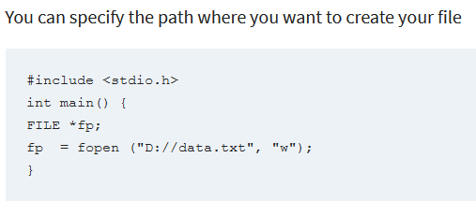

Slide 17
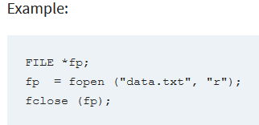
How to Close a file

Slide 18
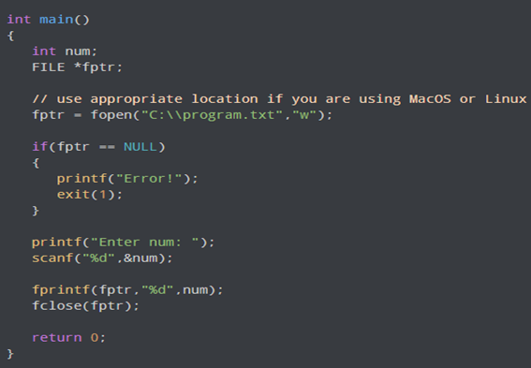
Write to a text file

Slide 19
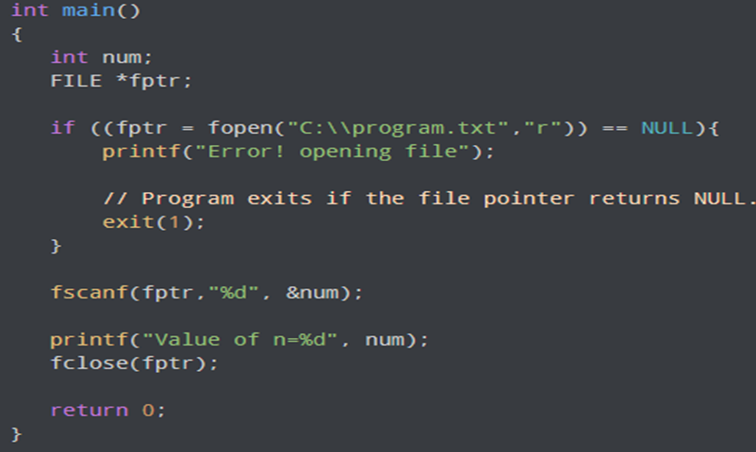
Read from a text file

Slide 20
Input/Output Operations on File getc and putc Functions
Simplest I/O functions are getc and putc.
• Handles one character at a time.
• Syntax:
putc(char, FILE *fp);
getc(FILE *fp);
• Eg:
putc(c, fp1);
c=getc(fp2);

Slide 21
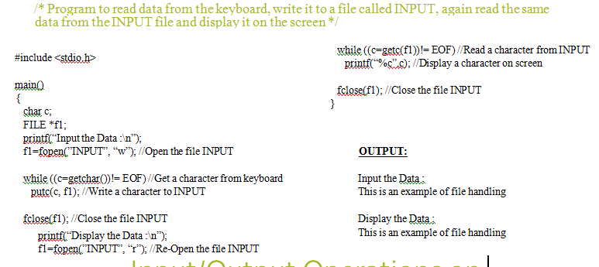
Example Program 2 /* Program to read data from the keyboard, write it to a file called INPUT, again read the same data from the INPUT file and display it on the screen */

Slide 22
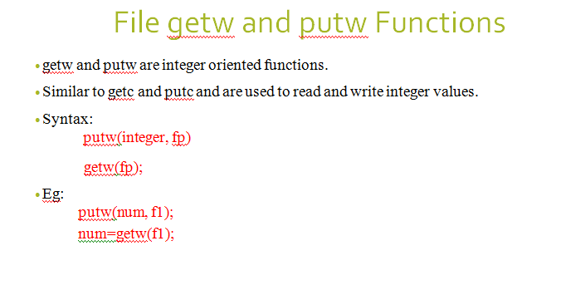

Slide 23
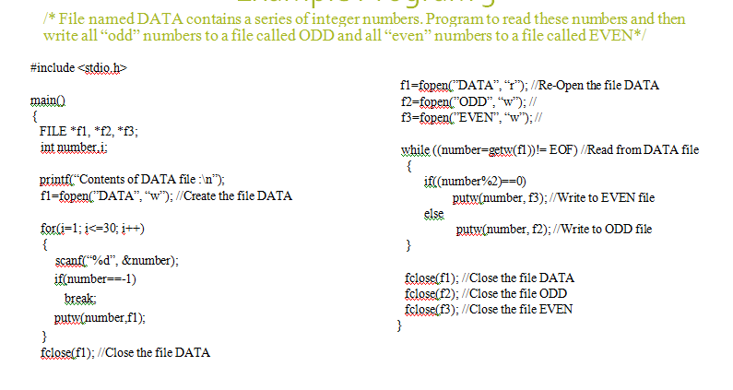

Slide 24
Enumerated data type (module 3)
In computer programming enumerated data type (enum) is used to create the group of constants.
It is a user-defined data type that consists of integer values, and it provides meaningful names to these values.
By default, const1 is 0, const2 is 1 and so on. You can change default values of enum elements during declaration (if necessary).

Slide 25
For example:
enum fruits{mango, apple, strawberry, papaya};
The default value of mango is 0, apple is 1, strawberry is 2, and papaya is 3. If we want to change these default values, then we can do as given below:
enum fruits{ mango=2, apple=1, strawberry=5, papaya=7, };

Slide 26
Example
#include <stdio.h>
enum weekdays{Sunday=1, Monday, Tuesday, Wednesday, Thursday, Friday, Saturday};
int main()
{
enum weekdays w; // variable declaration of weekdays type
w=Monday; // assigning value of Monday to w.
printf("The value of w is %d",w);
return 0;
}
Output
The value of w is 2

Slide 27
#include <stdio.h>
enum months{jan=1, feb, march, april, may, june, july, august, september, october, november, december};
int main()
{
// printing the values of months
for(int i=jan;i<=december;i++)
{
printf("%d, ",i);
}
return 0;
}
Output
1,2,3,4,5,6,7,8,9,10,11,12

Slide 28
Call by value and call by reference (mod 3)
There are two methods to pass the data into the function in C language, i.e.,
1) call by value
2) call by reference.
The parameters passed to the function are called actual parameters whereas the parameters received by the function are called formal parameters.

Slide 29
1) call by value
In call by value method, the value of the actual parameters is copied into the formal parameters.
we can not modify the value of the actual parameter by the formal parameter.
In call by value, different memory is allocated for actual and formal parameters since the value of the actual parameter is copied into the formal parameter.

Slide 30
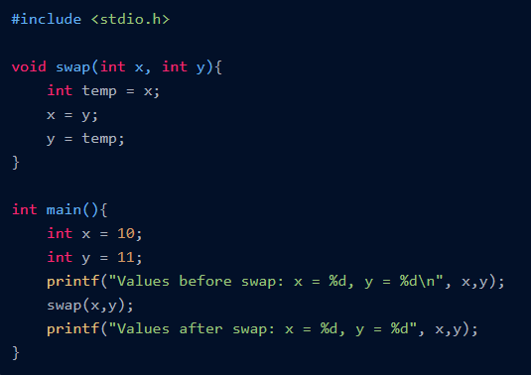

Slide 31
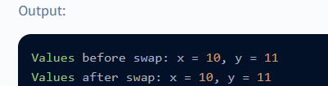

Slide 32
Call by reference
In call by reference, the address of the variable is passed into the function call as the actual parameter.
The value of the actual parameters can be modified by changing the formal parameters since the address of the actual parameters is passed.

Slide 33
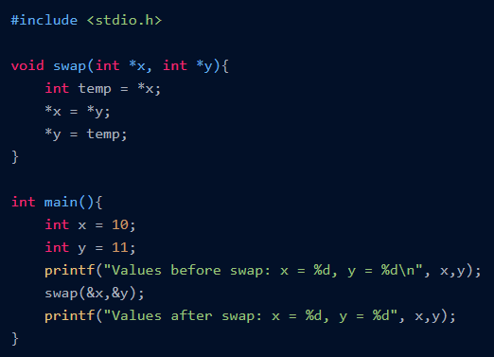

Slide 34
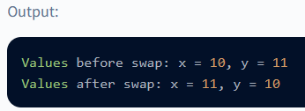

Slide 35
